Slide 1
Examining the research of Sande et al. (2009)
Hou Weitao
Mark Chong Yan Sheng

Slide 2
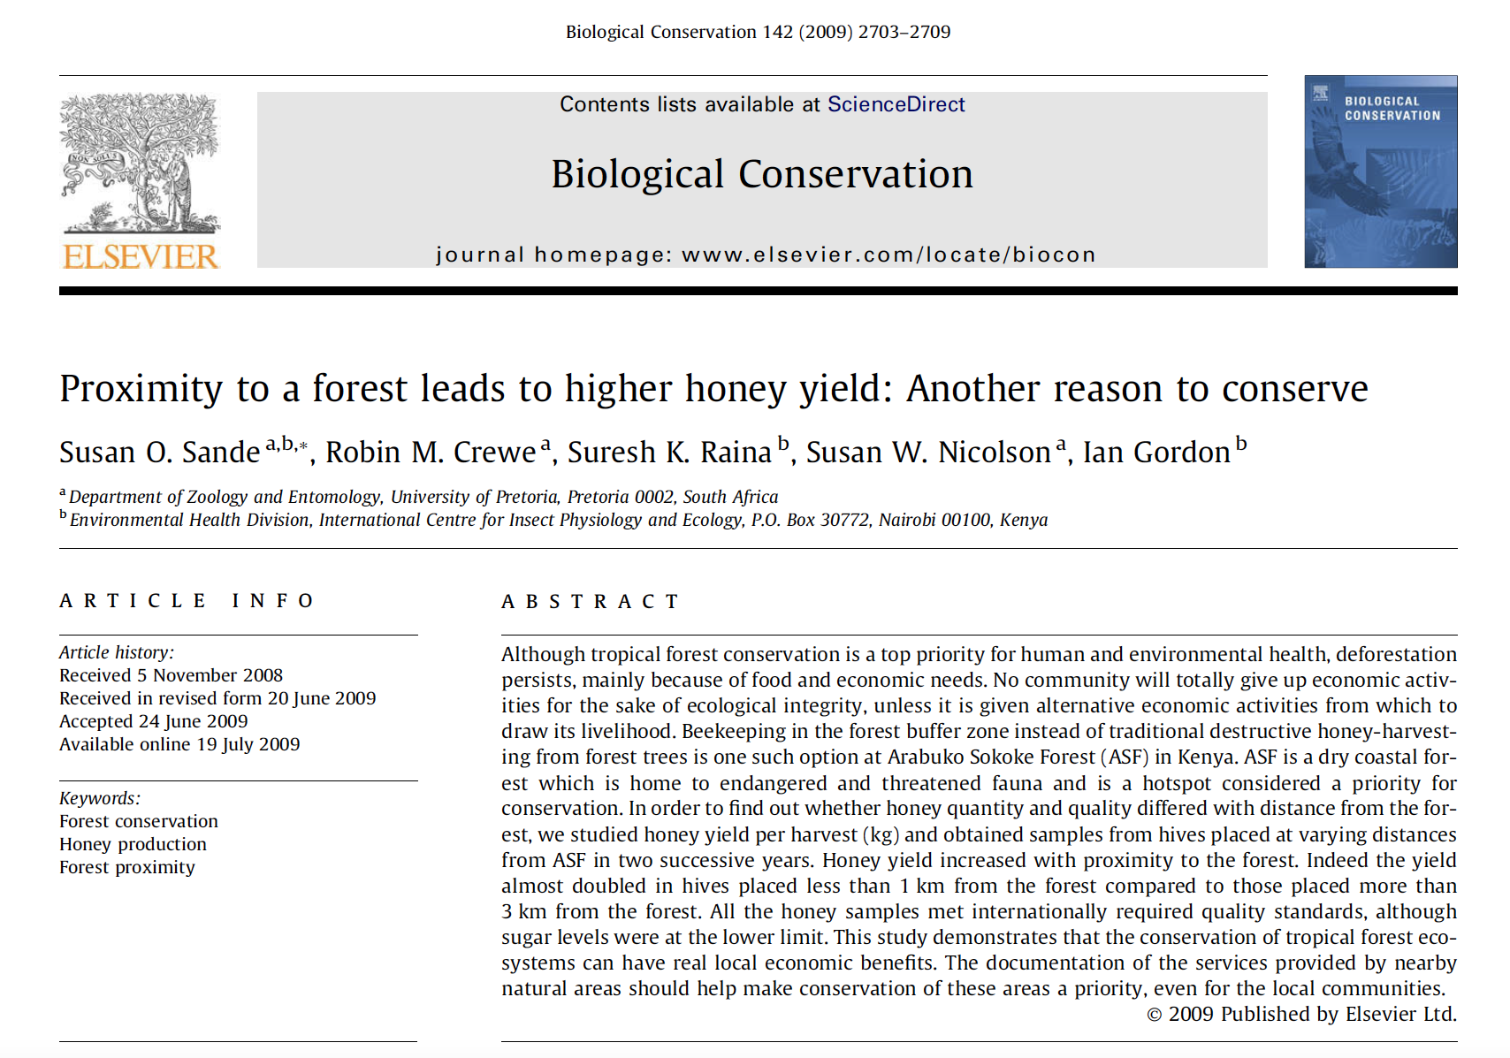
The Article

Slide 3
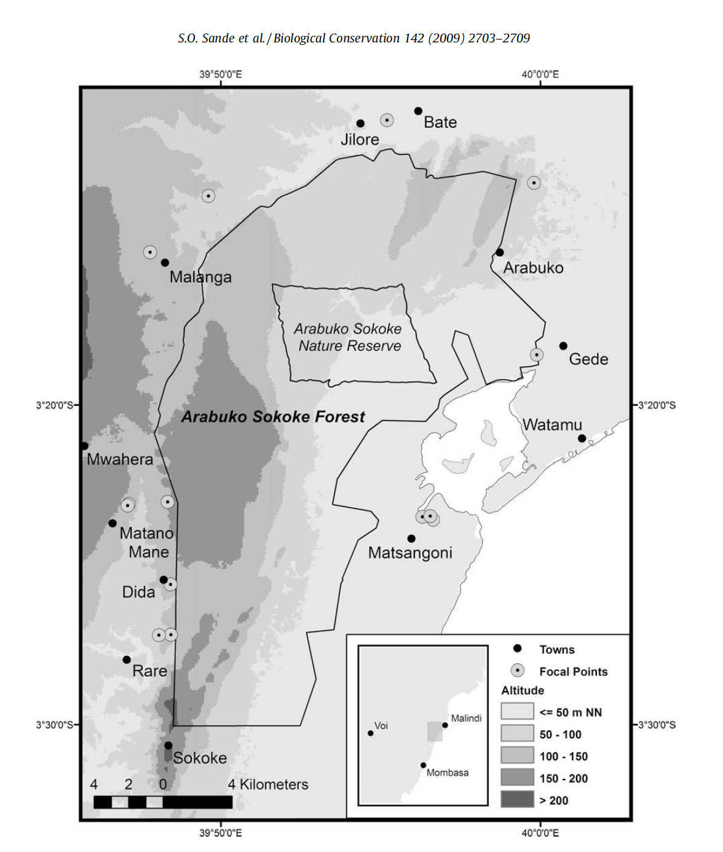
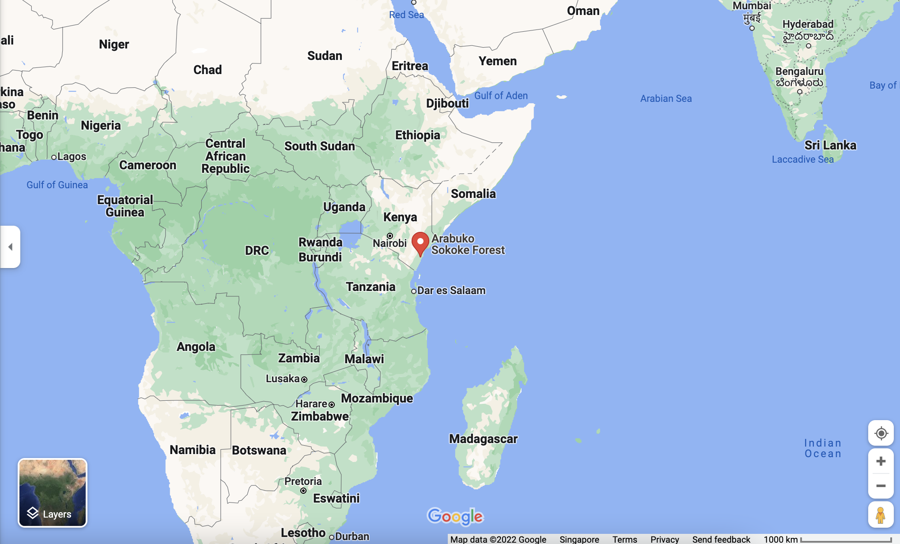
Study Site
Surroundings of Arabuko Sokoke Forest, along the eastern coast of Kenya.

Slide 4
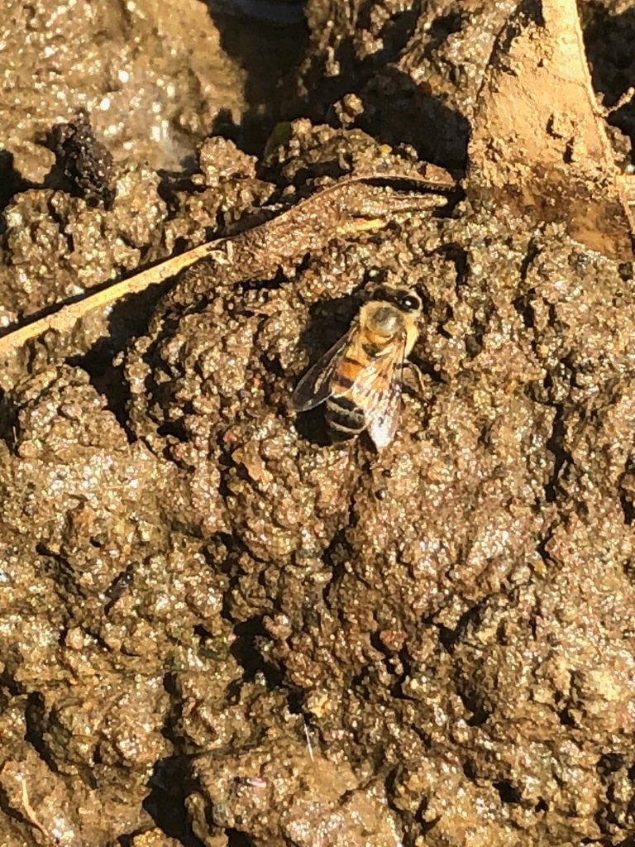
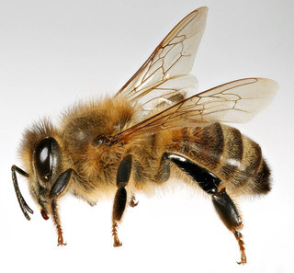
Honey Bees @ Study Site
Apis mellifera scutellata
Apis mellifera litorea
Hybrid
https://www.helpinghand.gi/index-of-species/insects-and-arachnids/33-african-honey-bee-apis-mellifera-scutellata
https://www.inaturalist.org/observations/51683761

Slide 5

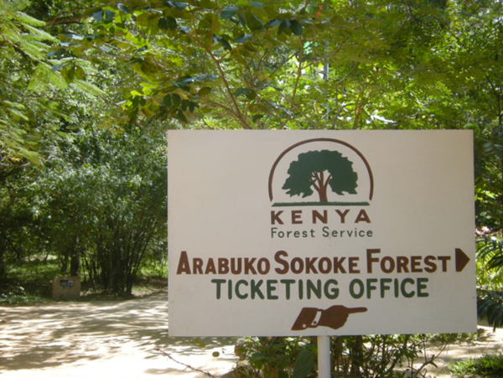
Research Question
Is honey quality and quantity/yield enhanced by the presence of a forest?
http://www.brucebyersconsulting.com/arabuko-sokoke-forest/

Slide 6
Data Collection
Global Positioning System (GPS) was used to record the locations of the hives situated in the buffer zone 0 to 5 km from the forest.
Three harvesting periods:
Aug-Oct 2006
Mar 2007
Aug 2007-Mar 2008 *
For each hive harvested, information on the hive type, its distance from the forest, and its honey yield were recorded.
Some samples were also collected for honey quality analysis in the lab.
2006/2007 (an atypical year)
* 2007/2008 (a typical year)

Slide 7
Dataset
Explanatory variable 1 (categorical): Distance of hive from forest
Three categories: < 1 km, 1-3 km, and 3-5 km
Explanatory variable 2 (categorical): Hive type
Three types: Langstroth, Top Bar, and Log
Response variable 1 (continuous): Honey yield (kg)
~analysed separately~
Response variable 2 (continuous): Honey quality (various biochemical properties as subvariables)

Slide 8
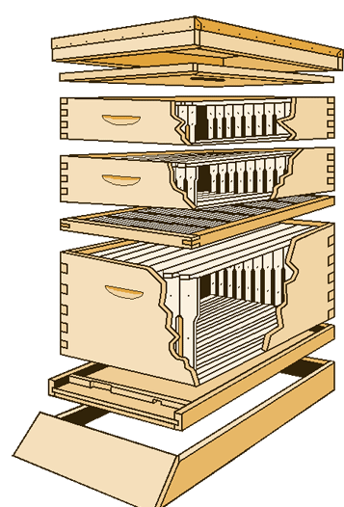
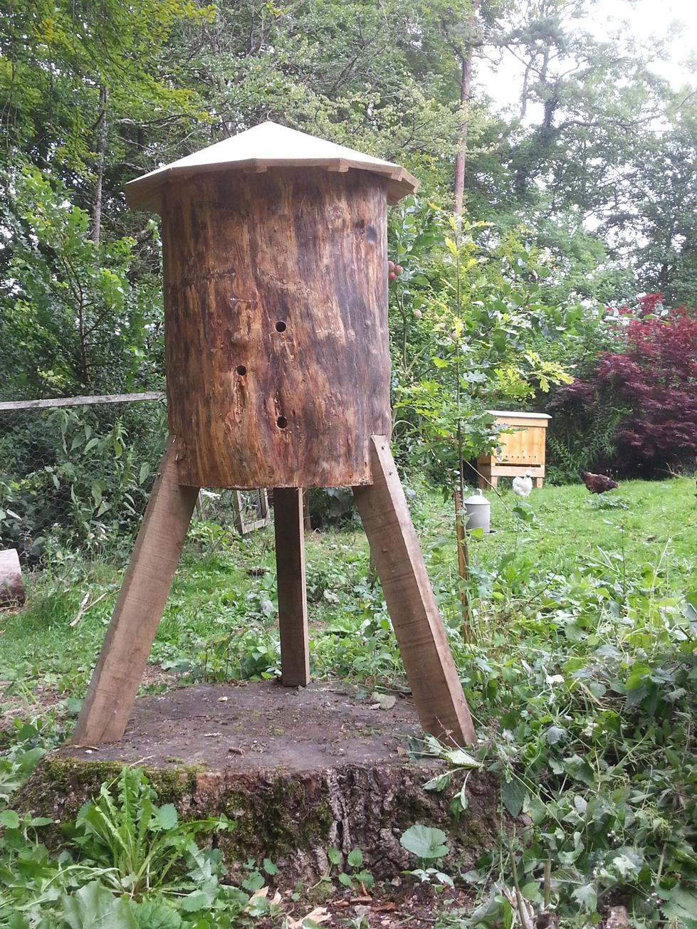
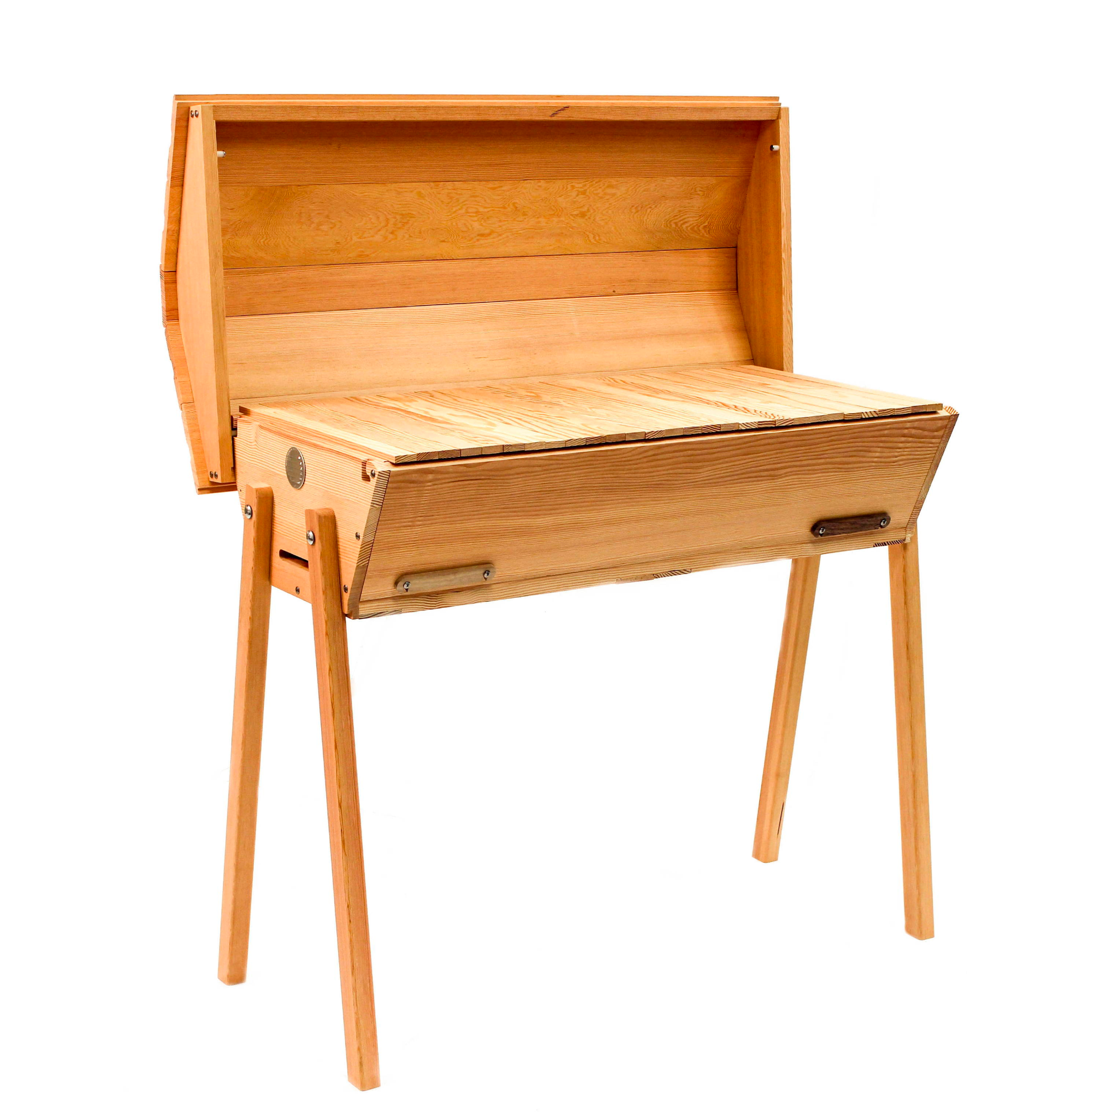
Hive Types
Log
Top Bar
Langstroth
https://beebuilt.com/pages/top-bar-hives
https://www.almanac.com/beekeeping-101-types-of-beehives
https://beekindhives.uk/2015/07/09/making-a-log-hive/

Slide 9
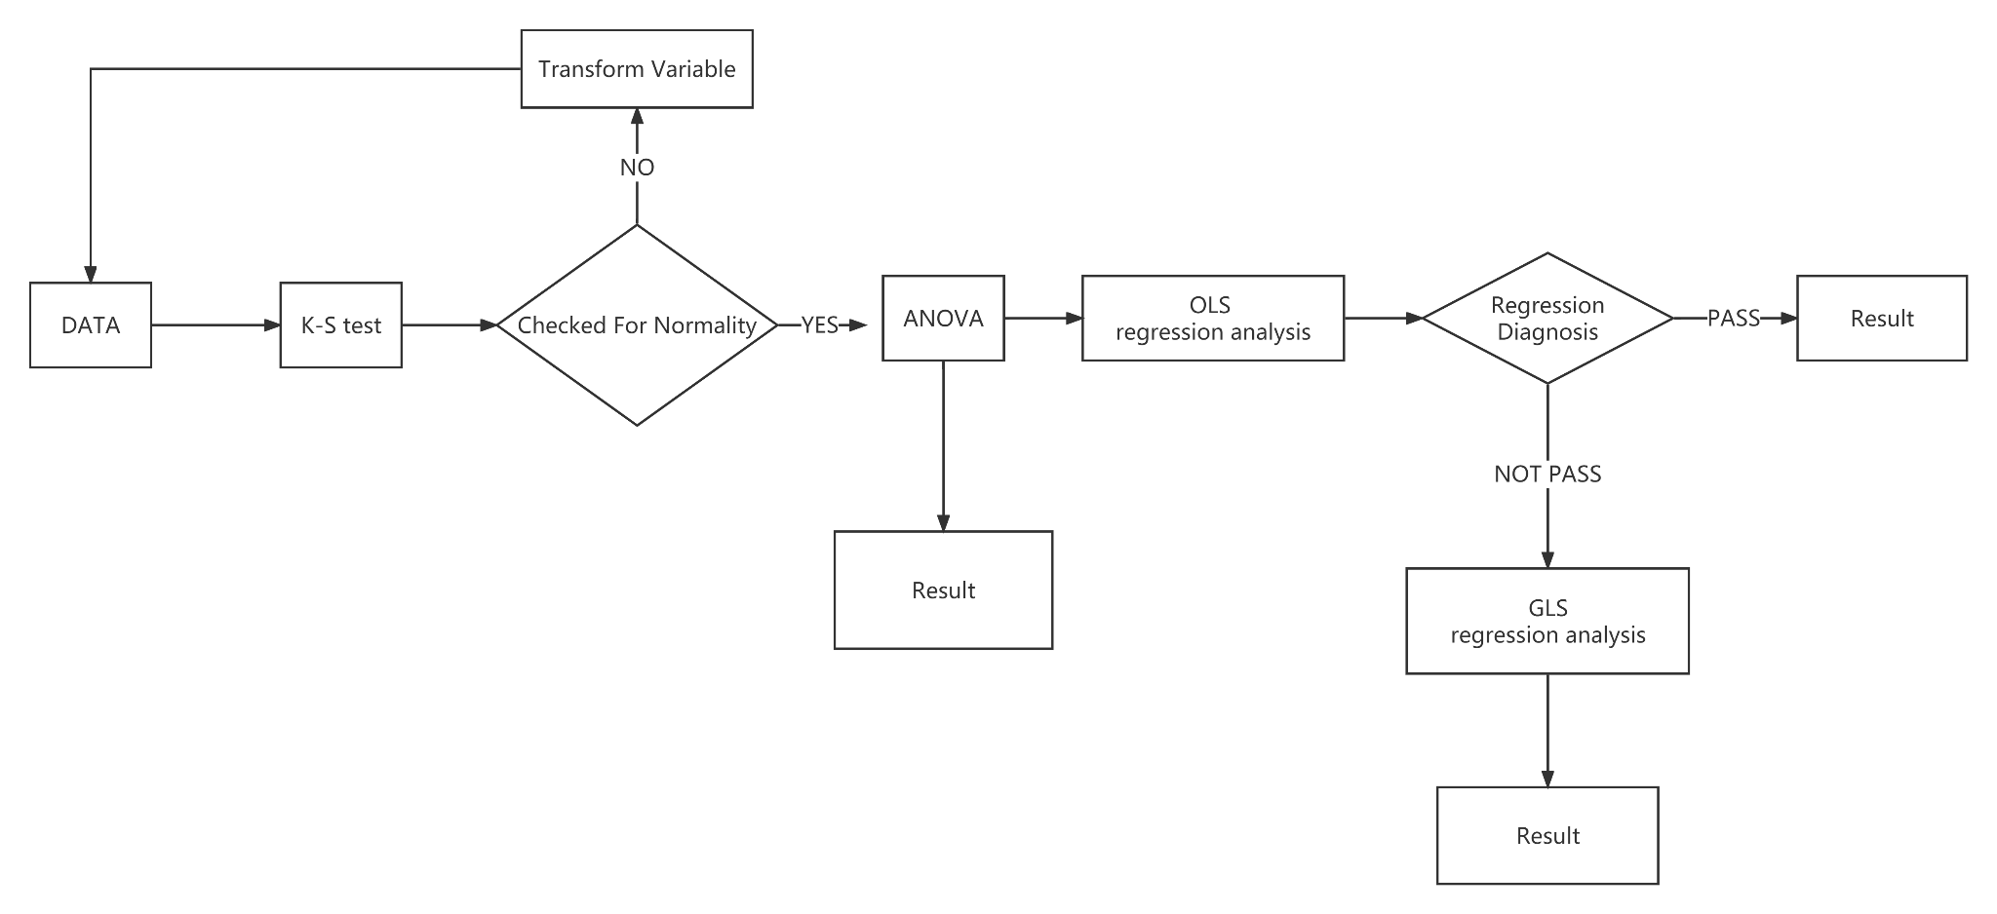
Data Analysis: Overview

Slide 10
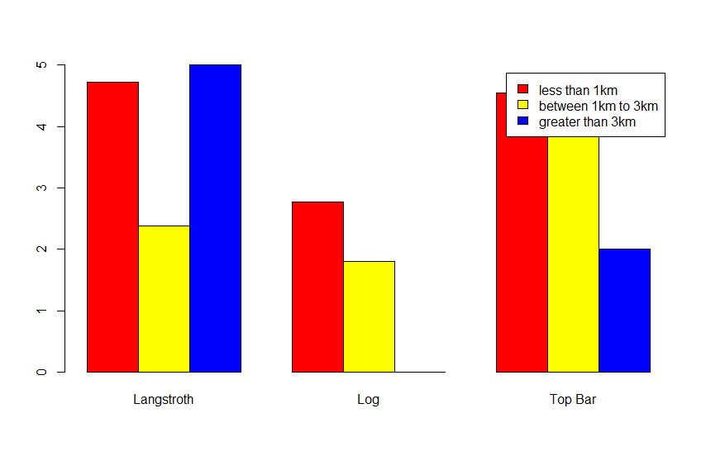
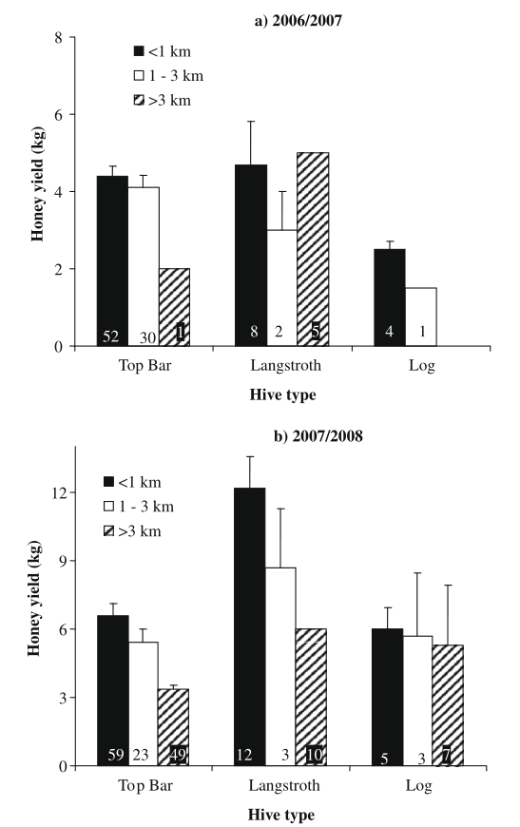
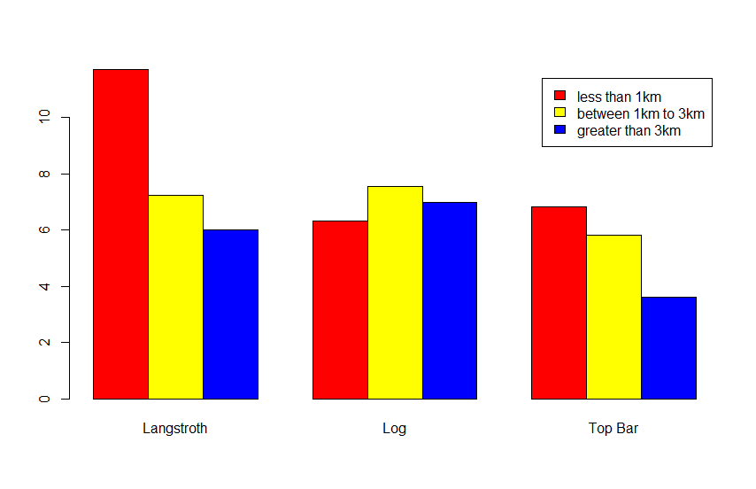
Plot in R

Slide 11
Data Analysis: Honey Yield
1. Check for normality using Kolmogorov-Smirnov test (K-S test)
2. Analysis of variance (ANOVA) with:
Distance and hive type as explanatory variables
Yield as the response variable
3. Where there were significant differences, Tukey’s test was performed
4. Regression analysis of combined yield data (spanning the years 2006-2008)
Ordinary Least Squares (OLS) - found to be invalid as some assumptions violated
Generalised Least Squares (GLS)

Slide 12
Data Analysis: Honey Quality
1. Analysis of variance (ANOVA) with:
Distance and hive type as explanatory variables
A particular biochemical property as the response variable
2. Where there were significant differences, Tukey’s test was performed
Same as Honey Yield, but without:
K-S Test
Regression analysis

Slide 13
Our Comments
We attempted to perform the analysis on R
(refer to appendix for the codes).
K-S test is one of the tests for normality.
We need to test for normality of the response variable, which is a continuous variable.
Shapiro-Wilk test may be more powerful than K-S test; but the power of all tests will decrease as the sample size decreases (Razali & Yap 2011).
Sande et al.’s (2009) sample size was quite large, so K-S test should be fine.
Performed for yield, but not quality - why?
The latter has many sub-variables that may be tedious to check.

Slide 14
Our Comments
ANOVA is appropriate for:
multiple categorical explanatory variables (each with two or more categories)
one continuous response variable
Both distance and hive type are categorical explanatory variables, each with three categories.
There is one continuous response variable:
either yield
or a certain biochemical property (moisture, glucose, acidity, etc.)

Slide 15
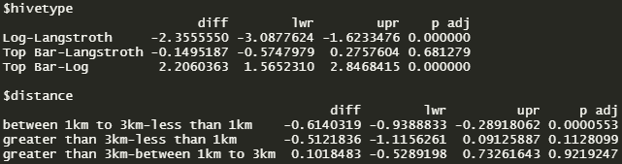
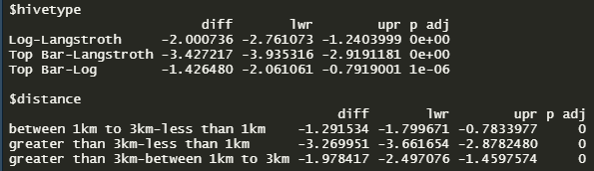
Our Comments
Tukey’s test reveals which pair(s) of means are significantly different from each other.
ANOVA only tells us whether a significant difference is present, but does not highlight between which pair(s) of means.
2006/2007: 2007/2008:

Slide 16
Our Comments
Regression analysis is appropriate for:
multiple continuous explanatory variables
one continuous response variable
But aren’t the explanatory variables categorical rather than continuous?
Each hive type had its own regression analysis, while distance seems to have reverted to a continuous variable.

Slide 17
Our Comments
Generalised Least Squares (GLS) linear regression was conducted because a number of Ordinary Least Squares (OLS) assumptions were violated:
The errors were correlated rather than independent.
Variance of the errors were not constant (heteroscedasticity)
Performed for yield, but not quality - why?
The latter has many sub-variables that may be tedious to perform a regression for each.

Slide 18
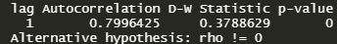
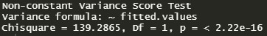
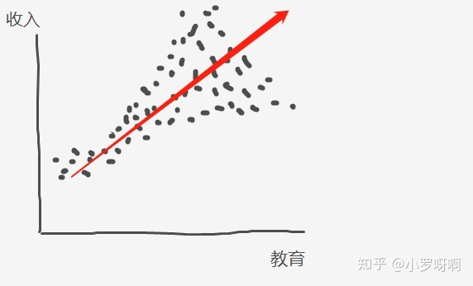
Checking for independence of errors
Checking for homoscedasticity
https://www.zhihu.com/people/xiao-luo-ya-a

Slide 19
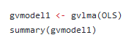
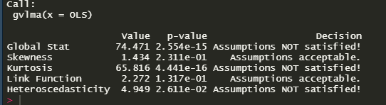

Slide 20
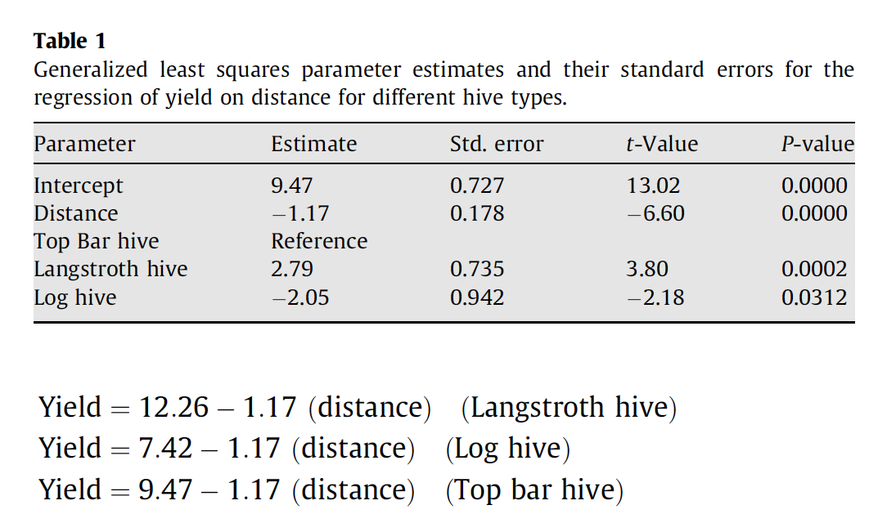
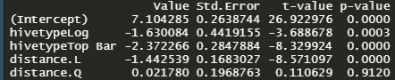
Our Comments
Distance as a continuous variable
Regression for each hive type separately

Slide 21
Final Remarks
Notable findings of Sande et al. (2009):
Yield is affected by:
distance — closer to forest, higher yield
hive type — Langstroth hives produce higher yield
Quality is affected by distance, albeit only in a minor way — closer to forest, honey contained higher fructose and glucose concentrations
Quality did not seem to be affected by hive type

Slide 22
Thank you for your kind attention!
Any questions?

Slide 23
Bibliography
Kabacoff, R. I. (2015). R in Action (2nd ed.). Manning Publications.
Frost, J. (n.d.). 7 Classical Assumptions of Ordinary Least Squares (OLS) Linear Regression. https://statisticsbyjim.com/regression/ols-linear-regression-assumptions/
Learn By Doing, Inc. (n.d.). Key Assumptions of OLS: Econometrics Review. https://www.albert.io/blog/key-assumptions-of-ols-econometrics-review/
Razali, N. M., & Yap, B.W. (2011). Power comparisons of Shapiro-Wilk, Kolmogorov-Smirnov, Lilliefors and Anderson-Darling tests. Journal of Statistical Modeling and Analytics, 2(1), 21-33. https://www.nrc.gov/docs/ML1714/ML17143A100.pdf
Sande, S. O., Crewe, R. M., Raina, S. K., Nicolson, S. W., & Gordon, I. (2009). Proximity to a forest leads to higher honey yield: Another reason to conserve. Biological Conservation, 142(11), 2703-2709. https://doi.org/10.1016/j.biocon.2009.06.023
Statistics How To (n.d.).Tukey Test / Tukey Procedure / Honest Significant Difference. https://www.statisticshowto.com/probability-and-statistics/statistics-definitions/post-hoc/tukey-test-honest-significant-difference/
Statistics Solutions (n.d.). Homoscedasticity. https://www.statisticssolutions.com/free-resources/directory-of-statistical-analyses/homoscedasticity/

Slide 24
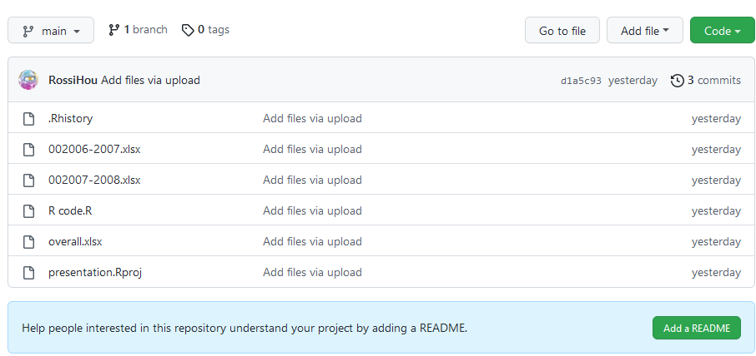
Appendix: R Codes
https://github.com/RossiHou/R_presentation

